Slide 1





Time Inc. - Salesforce Customer Support Applications
Major Tasks & Deliverables
Business & Functional Requirements
Technical Approach/Architecture Design
Wireframes & Design Compositions
Prototypes – Multiple Rounds of Iteration
Development & Integration
Quality Assurance & UAT Support
Deployment & Support
Training – SME’s, Developers, & Pilot Users
Project Approach
User-Centered Design
Desktop & Mobile
Integration – 5-6 systems integrations via RESTful web services including mainframe database for Customer Subscriptions, Personalization systems, and Salesforce
Personalization Configuration
Agile, Iterative Approach
MVP Product with Functional Roadmap
Challenges & Mitigation
Aggressive timeline
Accelerated planning, design, deployment, and training processes by embedding teams on-site at Affirma and client offices
Project Outcomes
The MVP deployment and roadmap milestones for enhanced functionality were delivered on time and on budget.
Customer was emphatically satisfied
Continued to engage with Affirma on managed service partnership.

Slide 2
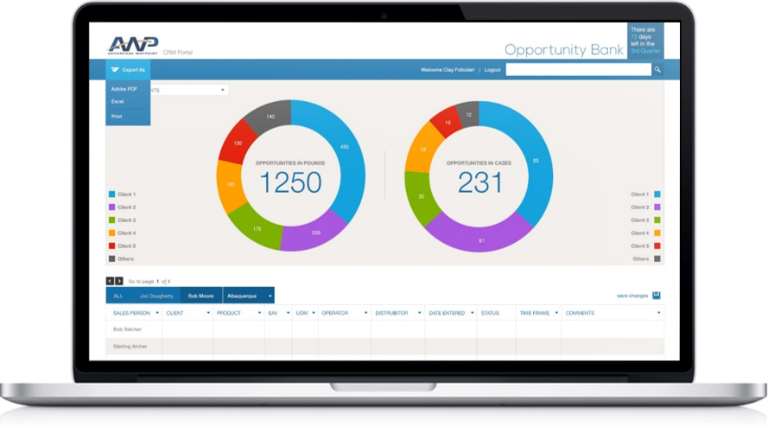

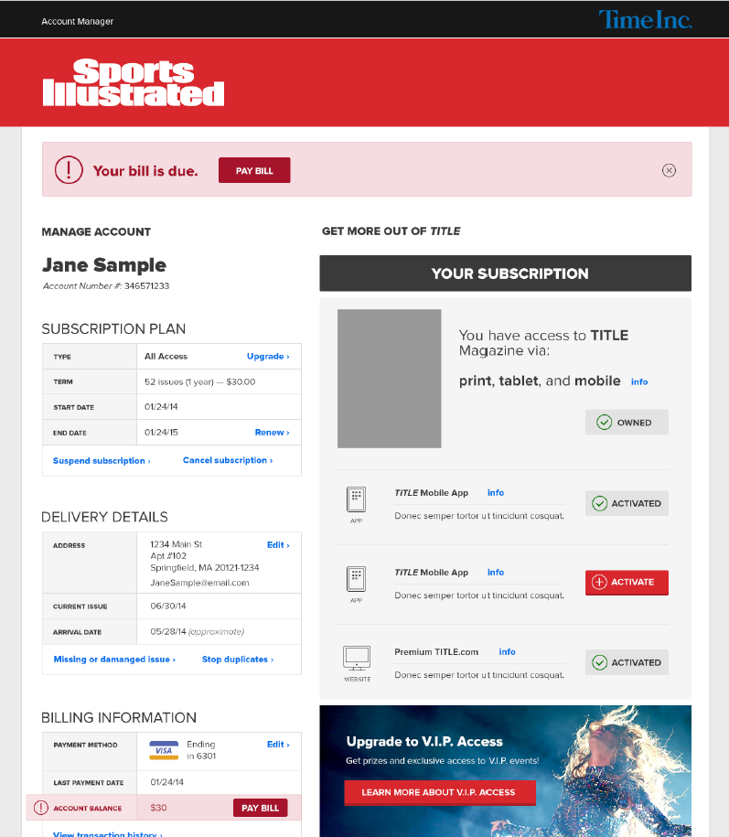
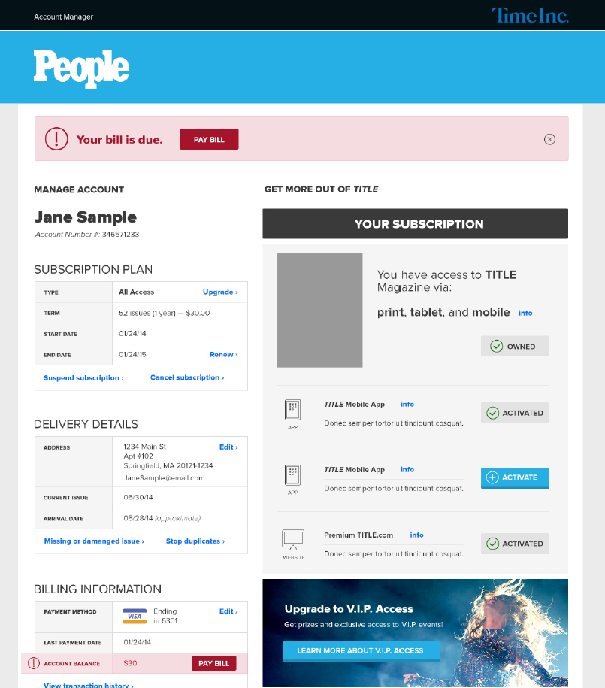

Time Inc. - Salesforce Customer Support Applications
Increased
Revenue through cross-selling
Personalization
Improved user engagement
Notes:
Enterprise level – massive scale
Highly Personalized
Membership based
Complex integrations – SSO, CRM and Membership Data (mainframe)

Slide 3


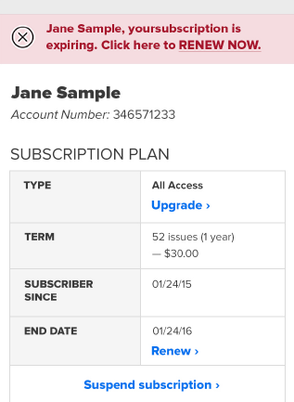
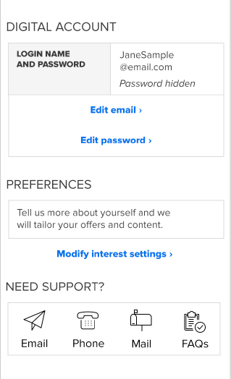
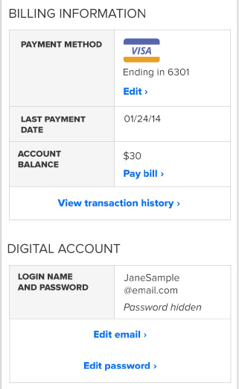
Time Inc. - Salesforce Customer Support Applications
Notes:
Enterprise level – massive scale
Highly Personalized
Membership based
Complex integrations – SSO, CRM and Membership Data (mainframe)

